Slide 1



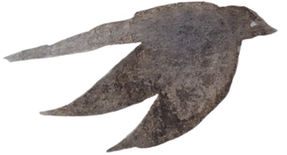


Smart BIN
IOT system Support for manage Bin at apartment
Lecturer: PGS.TS Lê Trung Quân
KS. Nguyễn Văn Bảo

Slide 2



CONTENT
Introduction Problem
Flatform ( hardware + software )
System architecture
Demo project

Slide 3


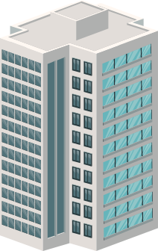

Problem
An apartment building has many floors, each with many trash cans. How to control such many trash cans without having to check each one?

Slide 4
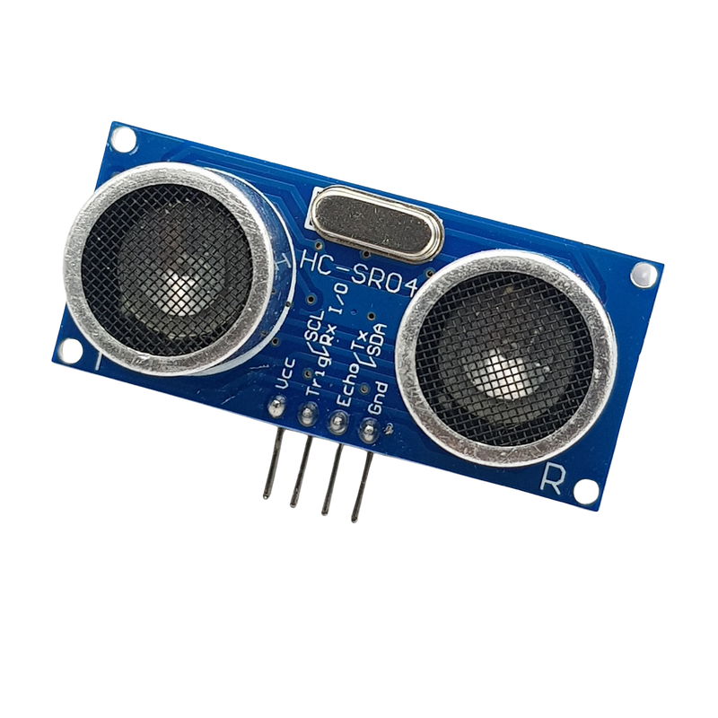
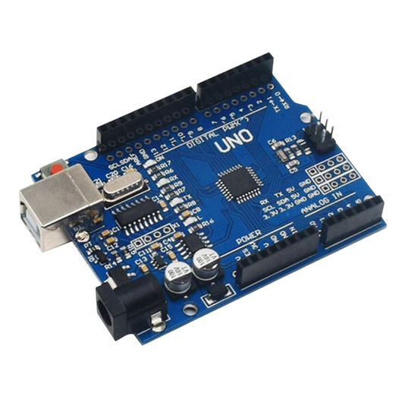
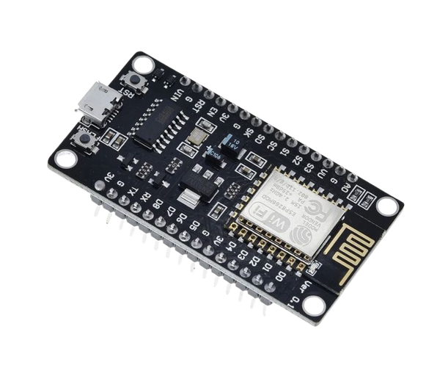
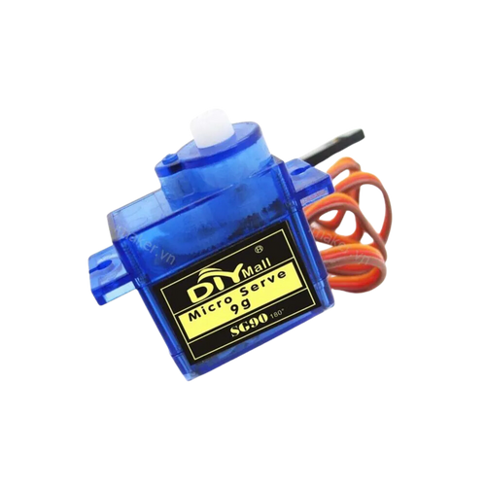
PLATFORM
NODEMCU-ESP8266 Wifi
SRF04 Ultrasonic Distance Measuring
Servo SG90
Arduino Uno R3

Slide 5


PLATFORM SOFTWARE
Visual studio code
Arduino IDE

Slide 6


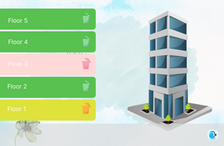





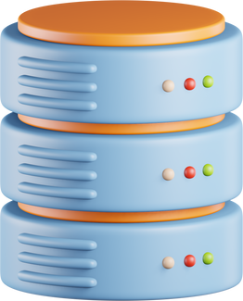
system architecture
Client
Back End
Web Service
Authentication
TrashStatus
HTTP Requrest
HTTP Response
HTTP Request / Response
API
HTTP Requrest
HTTP Response
Process
Query
API

Slide 7

DEMO

Slide 8
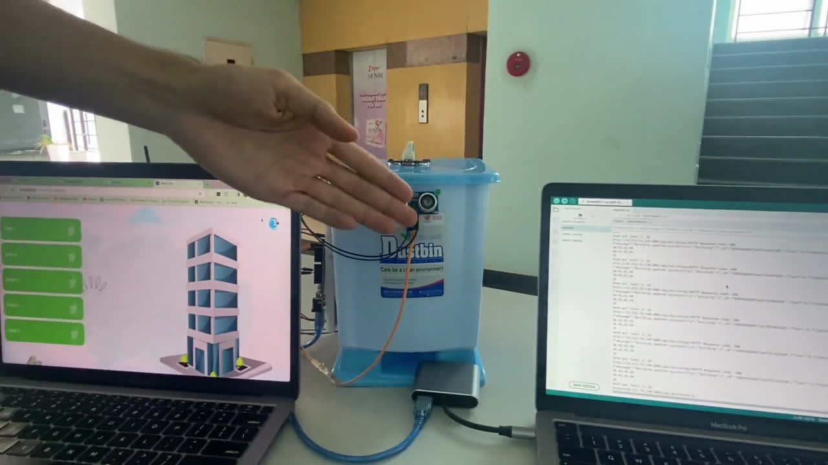

Slide 9
Group 8
Number | Student name | ID | Tasks
1 | Nguyễn Nhất Thưởng | 20522000 | Warning when trash is full, design UI/UX, deloy website, bin setting
2 | Lê Văn Sỹ | 205221854 | Automatic opening and closing the trash lid, write API, bin setting

Slide 10
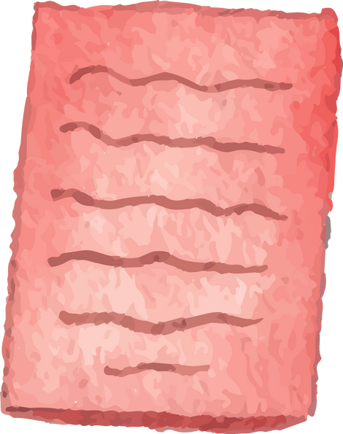


Thank you for listening

